Slide 1
MathGPT – Generate Practice Tests for Mathematics using AI
By Adhvik Chakraborty
Semester 1 Block 2
January 17, 2024
David Thompson Secondary School

Slide 2
TABLE OF CONTENTS
01
02
03
Abstract & Introduction
Background Info
Lab Question, Hypothesis, Purpose
04
05
06
Materials, Procedure
Data & Analysis
Future Improvements & conclusion

Slide 3
01
Abstract & Introduction

Slide 4
Abstract
STEM education plays a crucial role in creative thinking and practical knowledge for a child’s development.
Basic mathematic skills and proficiency levels of students are low which is a serious issue, especially for developing countries.
This project proposes the solution of improving mathematics skills for school grade students through a problem-solving approach.
This project developed an innovative technique that tries to leverage the mathematics knowledge and capabilities of AI models.
The technique was demonstrated by developing a software application named MathGPT that uses OpenAI GPT3.5 which is a large language model (LLM)
MathGPT allows the user to input a question, the desired complexity, the number of practice questions, and output specification, which outputs the generated question, the answer, and the topics covered.
After analyzing the results, it can be seen that by employing the technique proposed in the hypothesis, it is possible to bring out the mathematics capabilities of the LLMs and overcome its limitations.

Slide 5
Introduction – Improving math skills
STEM education plays a vital role for a child’s development and future career prospects
Math is the most important skill applicable across all STEM disciplines
Unfortunately, most students are below proficiency level in math
Math is necessary for students who want to pursue a successful job in the STEM industry.

Slide 6
02
Background Info

Slide 7
Background Info
AI has made significant improvements in the field of mathematics
AI (Artificial Intelligence ) / Machine Learning (ML), is a computer algorithm that focuses on analyzing and finding patter
AI/ML deals with designing a computer model that learns to perform its task on its own.
For a computer to learn first, a neural network based on the model is created and then taken through a training stage where it is given several example inputs and its correct output
Once the model learns then the model can be used to do the prediction for an input it has never seen before. This is called ML inference, and the ML is ready for use
Recently, Generative AI based large language model (LLM) can understand human language, can generate text, and can also perform other various text-based tasks
It has become popular and due to success of OpenAI’s ChatGPT which can perform many complex tasks like passing tough exams

Slide 8
03
Lab Question, Hypothesis, Purpose

Slide 9
Lab Question, Hypothesis, Purpose
Hypothesis
Purpose
Lab Question
Is it possible to efficiently utilize an AI based Large Language Model’s capability to generate mathematics practice questions tailored to a student’s needs?
The purpose of this project is to help students learn mathematics through a problem-solving approach by using the mathematical capabilities of the AI based Large Language Model to generate a large number of practice questions of various complexities based on a given specification that will help develop a deeper understanding and engagement in students.
If a technique is devised to leverage the mathematics capabilities of AI based large language model and at the same time understand and overcome its limitations, then it would be possible to develop a cheap and user-friendly tool to help students provide sufficient practice questions that eventually improve their mathematics skills.

Slide 10
04
Materials, Procedure

Slide 11
Materials
Hardware
PC/Laptop
Internet Connection
Software
Google Colab
OpenAI API keys
Langchain
Gradio

Slide 12
Procedure: Part 1 - Software Design
MathGPT has been developed using python and is running in Google Colab Notebooks
The software (MathGPT) consists of 3 modules
The input and output module has been developed using an open-source python package called Gradio.
The Math Engine module contains the main logic of MathGPT
OpenAI Cloud
OpenAI API
Python on Google Colab
Gradio
Math Engine
(Algorithm)
Gradio
Input
Output

Slide 13
Procedure: Part 2 - OpenAI APIs
Langchain is an easy to use open-source framework that allows developers to work with LLMs and ML to develop LLM-powered applications using python or JavaScript
In this project, Langchain is used to call the LLM models, providing prompts and parsing the response
The steps to give a query to LLM and receive response are as follows:
A template was created which contains the commands for the LLM. Writing a clear, precise, and meaningful template is essential for getting the desired response.
Next, a response schema is created to tell the LLM how the output should be structured
Then the output parser is created to retrieve the LLM’s response.
Next, the PromptTemplate() is made to finally structure the complete query and the output format which is necessary to pass to the LLM.
Finally, the call is made to the LLM which responds to the query as per the instructions.

Slide 14
Procedure: Part 3 - Prompt Engineering
To assist the LLM with identifying the topic of the question Prompt Engineering is used.
In this project Few-shot prompting has been used, which means clear, definitive, and descriptive examples provided to the model to bound and guide the topic response for a given question
To perform prompt engineering, the steps are shown below:
An example format template is created which tells the LLM how the examples are formatted and passed to the PromptTemplate API.
The prompt format along with the actual examples are passed to the FewShotPromptTemplate() API that prepares the message and finally passed to the LLM using the LLMChain() API.
The prompt engineered LLM is coupled with the base LLM to work as fine-tuned LLM to serve purposes of this project work.

Slide 15
Query and Training GPT 3.5
Query
Training
topic_template = """
You are a mathematics expert and assistant who helps answer mathematics questions. .
A user will pass in a mathematics question and you should classify the topic of the question.
The topic should be one of the following class: Numbers and Numerations, Geometry, Place Value, Fractions, Units of Measurement, Probability, Algebra, Statistics, Ratios and Proportions, and Patterns.
Only return the topic and nothing
What topic is this mathematic question: \n{format_instructions}\n{question}?
"""
Prompt_examples = [
{"question" : "What is 234-187?", "topic" : "Numbers and Numerations"},
{"question" : "Which one is greater 12/43 or 1/2?", "topic" : "Fractions"},
{"question" : "The perimeter of a rectangular pool is 48 meters. If the length of the pool is 11 meters, then find its width.", "topic" : "Geometry"},
{"question" : "A bicycling club has 88 members, of which 36 are males and the rest are females. What is the ratio of females to males?", "topic" : "Ratios and Proportions"}

Slide 16
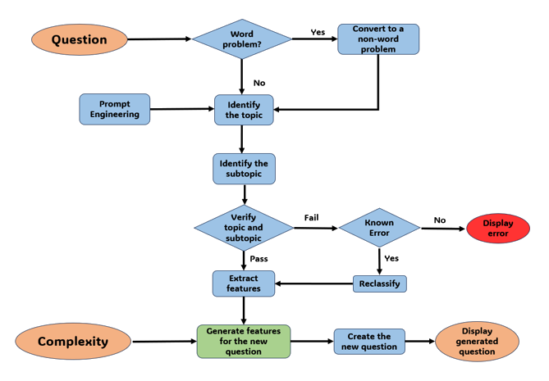
Procedure: Part 4 - Algorithm (Math Engine)
First, the question is taken as an input
It is classified as a word or non-word problem
If the question is not a word problem, the LLM is used to predict the topic of the problem.
The LLM predicts the subtopic in that topic.
To confirm that the question has been classified correctly they are both verified.
For feature extraction, the LLM’s mathematical understanding is used to break the problem down into its mathematical components.
The new features are the generated using the current features and the desired complexity
The original question and the new features set are used to compose an entirely new question

Slide 17
05
Data & Analysis

Slide 18
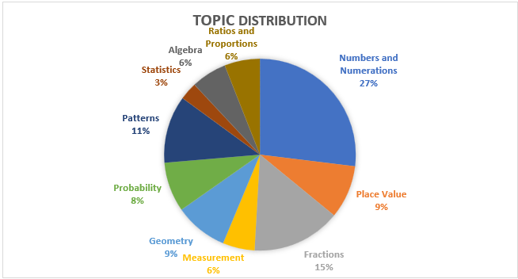
Validation and Training list
Questions from various topics are chosen to create a validation and training list
The number of questions per topic was chosen based on the variety, and complexity of the questions in each topic
In the validation and training list 36% were word problems and 64% were non word problem questions.

Slide 19
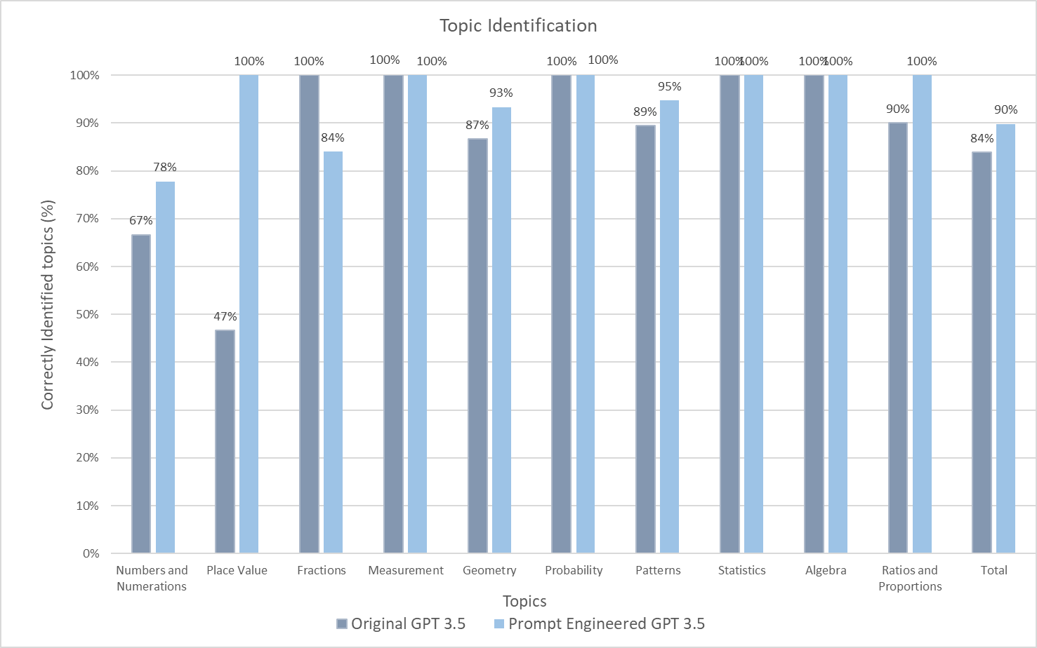
Data & Analysis: Part 1 - Topic and Subtopic Identification
The topics: Fractions, Measurement, Probability, Statistics, and Algebra were all perfectly identified (100%)
The rest of the topics have errors in the identification of the questions
The LLM after prompt engineering could do a much better job at identifying the correct topic
This can be seen as Numbers and Numerations increased by 11%, Place Value increased by 53%, and many other topics increased in percentage.
However, it is observed that the Fractions worsened and decreased by 16%
Overall topic identification with prompt engineering increased the percentage by 6%

Slide 20
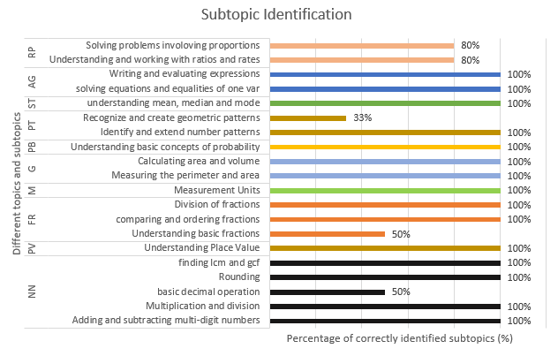
Data & Analysis: Part 1 - Topic and Subtopic Identification
Once the topic has been correctly identified the bar graph to the left shows the subtopic classification by the LLM
Most of the topic’s subtopics are being identified correctly for example, Place Value, Units of Measurement, Geometry, Probability, Statistics, and Algebra.
The 4 topics that have subtopics being misidentified are: Number and Numeration, Fractions, Patterns, and Ratios and Proportions.
These results shows that we can leverage the LLMs capabilities to bound the problem to a specific topic and subtopic as per the mathematics syllabus which can be used to build the rest of the logic

Slide 21
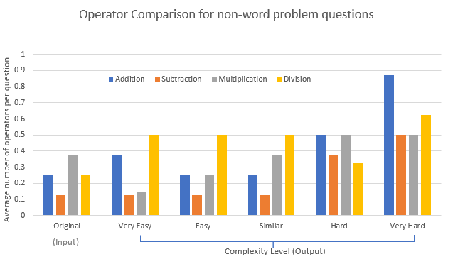
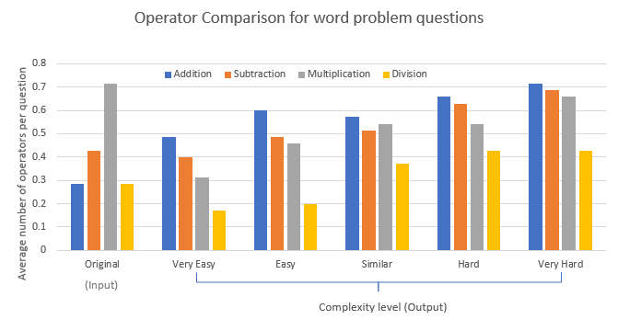
Data & Analysis: Part 2 - Question Generation
The bar graphs show the average number of operators per question for word and non-word problem questions
For both word and non-word questions the total number of operators are almost same between Original, Very Easy, Easy and Similar
As the complexity increases further, the average number of operators also increases

Slide 22
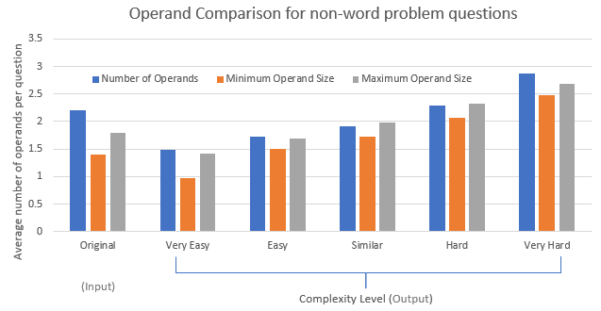
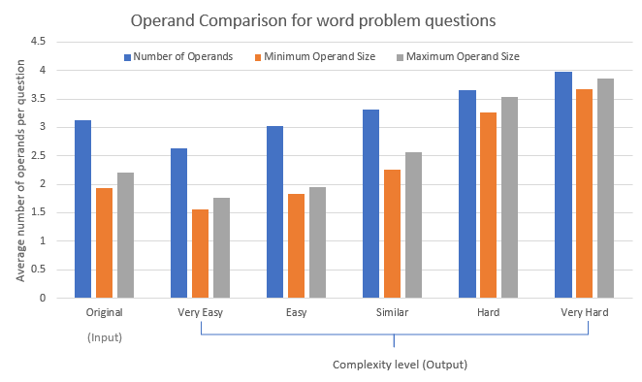
Data & Analysis: Part 2 - Question Generation
The bar graphs show the average number of operands per question for word and non-word problem questions
Just like for the operators as the complexity increases the average number of operands also increase.
The original questions have around the same number of operands per question as the Similar complexity
This shows the importance of complexity factor in generation of question

Slide 23
Data & Analysis: Part 4 - Practice Test Paper Generation Trials
Finally, to validate the main objective of this project and verify the correctness of MathGPT, 3 trials were performed using an actual mathematics test papers
The questions from the original test paper and the generated questions in the practice test papers are compared manually to find out the similarity, number of word problems, non-word problems, number of misleading questions, and duplicates
The result of the three trials show that the generated practice test paper has the same number of questions
Moreover, the distribution of questions per topics also remain consistent with the original test paper
No duplicate and misleading questions were generated validating the accuracy of MathGPT
Features | Orig | 1st Trial | 2nd Trial | 3rd Trial
Total questions | 22 | 22 | 22 | 22
Word problem | 17 | 16 | 17 | 17
Non-word problem | 5 | 6 | 5 | 5
Misleading questions | 0 | 0 | 0 | 0
Duplicates | 0 | 0 | 0 | 0

Slide 24

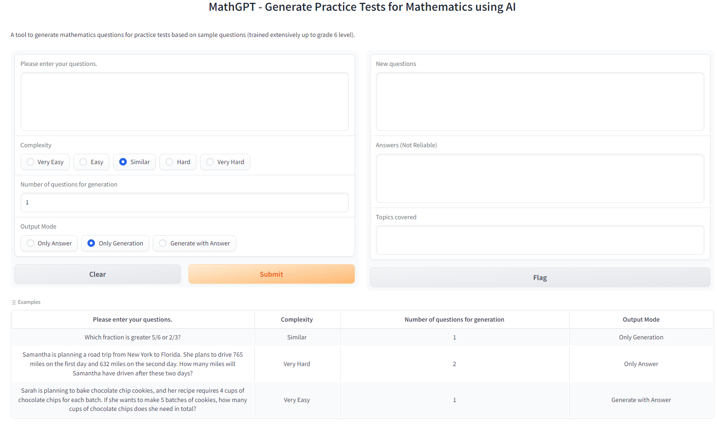
MathGPT Usage

Slide 25
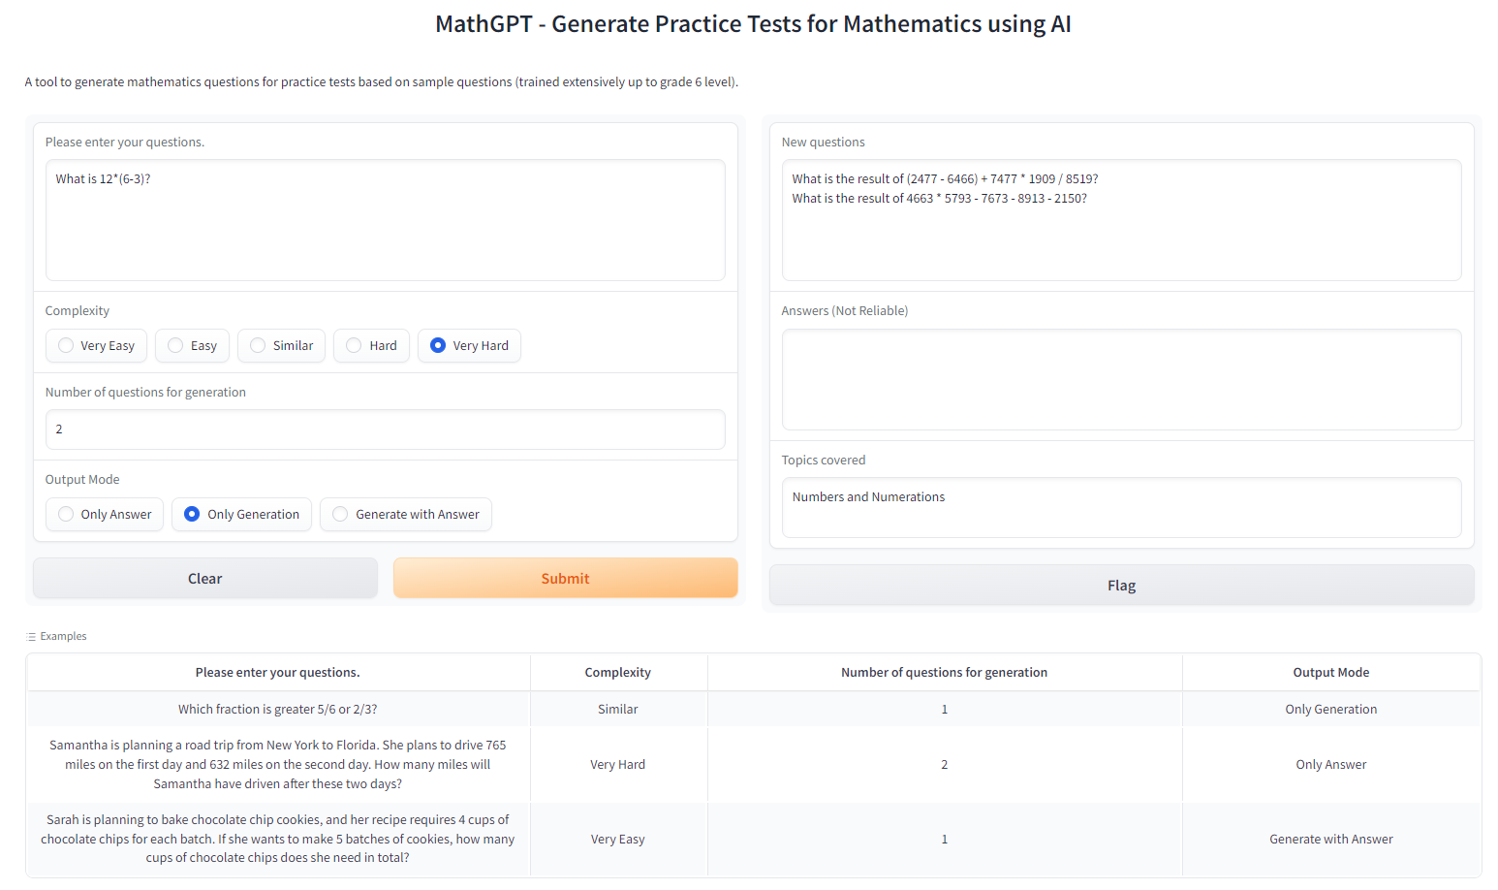
MathGPT in Action

Slide 26
06
Future Improvements and Conclusion

Slide 27
Future Improvements
To make MathGPT more user friendly some features can be added to it.
The input and output can have the capability to take and produce pdf files. That way the user can directly provide the existing test papers and can save the generated test papers as well
It can also extend the question generation capabilities and complexity by allowing mixing of topics and extending beyond grade 6 level mathematics to cover complete K-12 school syllabus.
To improve its quality of question generation and providing answer it can choose more advanced, recent, and mathematically capable LLMs.
It can also make use of open source LLM and execute locally to minimize the cost and response time associated with using OpenAI cloud at present.
All these features would help make MathGPT excel and among the best in AI applications to solve world problem.

Slide 28
Conclusion
The tool MathGPT, an AI based LLM was developed in this project and the results obtained using it proved the hypothesis to be accepted
Using MathGPT students can generate sufficient practice questions for specific areas and additionally generate complete practice test papers to prepare confidently for the exams.

Slide 29
References
References
Arnold, S. (2023, June 4). Artificial Intelligence: What Is It and Why It Matters. Retrieved from LINQTO: https://www.linqto.com/blog/artificial-intelligence-what-is-it-why-it-matters/?matchtype=&keyword=&cid=19212471099&agid=&device=c&placement=&creative=&target=&adposition=&devicemodel=&GA_loc_physical_ms=9001501&aceid=&network=x&utm_term=&utm_campaign=Ripp
Harrison Chase, A. N. (n.d.). LangChain for LLM Application Development. Retrieved from DeepLearning.AI: https://www.deeplearning.ai/short-courses/langchain-for-llm-application-development/
Kim Hazelwood, S. B. (n.d.). Applied Machine Learning at Facebook: A Datacenter Infrastructure Perspective. Retrieved from Meta: https://research.facebook.com/publications/applied-machine-learning-at-facebook-a-datacenter-infrastructure-perspective/
Refer to the Lab Report for the rest of the references.

